Slide 1


AgriSmart
AI-Powered Disease Detection & Sustainable Recommendations
OUR TEAM:
Abbu Saikiran
Muneera
Penthala Shyam Prasad

Slide 2
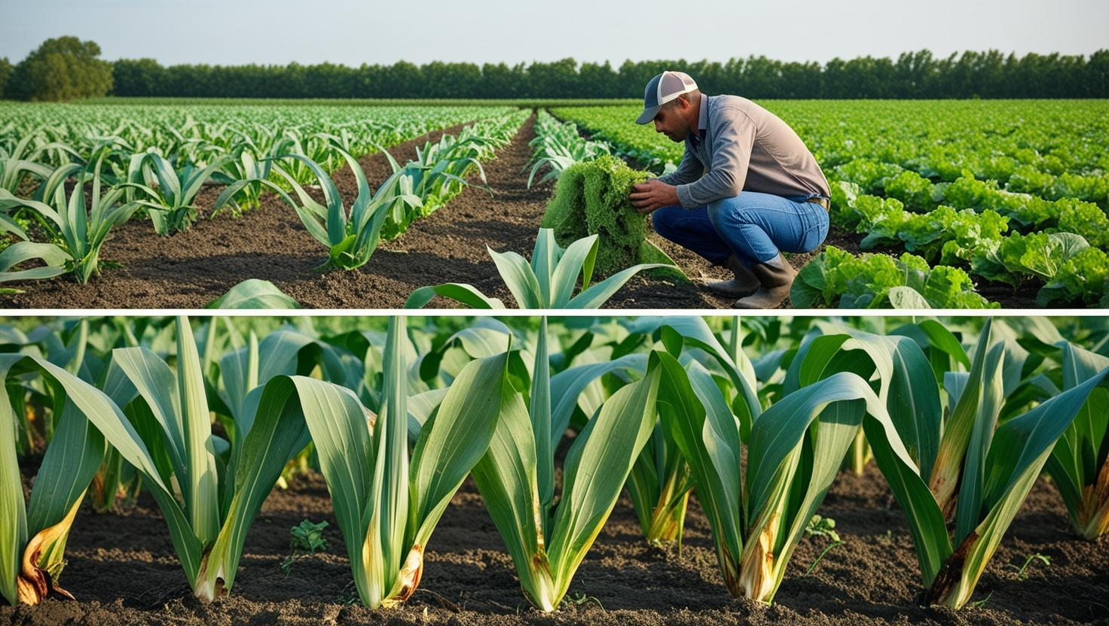
Project Objective:
Problem Statement
Project Overview-Introduction
Solution
How it Works
Results and Performance
Wow factor
Benefits
Future Scope
Block Diagram
Conclusion

Slide 3
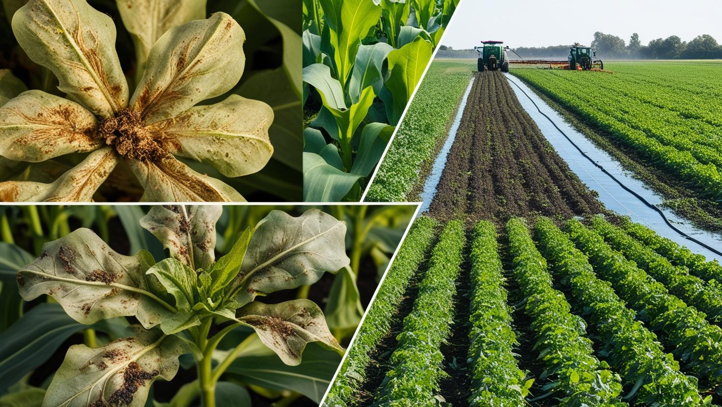
Problem Statement
Modern agriculture faces significant challenges due to the increasing incidence of crop diseases, inefficient use of fertilizers, and the over-application of pesticides.
Traditional methods of identifying crop health issues are manual, time-consuming, and often inaccurate, leading to delayed responses and reduced crop yield.
Additionally, excessive use of chemical inputs not only increases farming costs but also harms the environment and soil fertility.

Slide 4
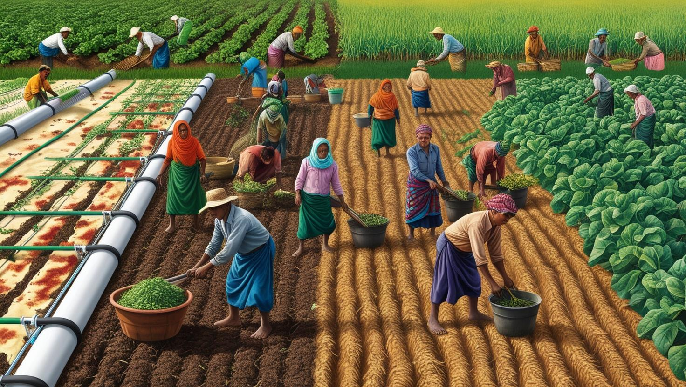
Project Overview-Introduction
Agriculture remains the backbone of many economies, especially in developing regions where the majority of the population depends on it for livelihood.
However, modern agricultural practices face several challenges including crop diseases, overuse of chemical inputs, and a lack of timely intervention.
These issues not only reduce crop yield but also harm the environment and soil health.
Excessive use of chemical fertilizers harms soil health, pollutes water, and kills beneficial microbes.
Nutrient runoff, especially nitrogen and phosphorus, causes eutrophication—leading to algae blooms, oxygen loss, and aquatic death.
Over time, this makes soil acidic and farming less sustainable.

Slide 5
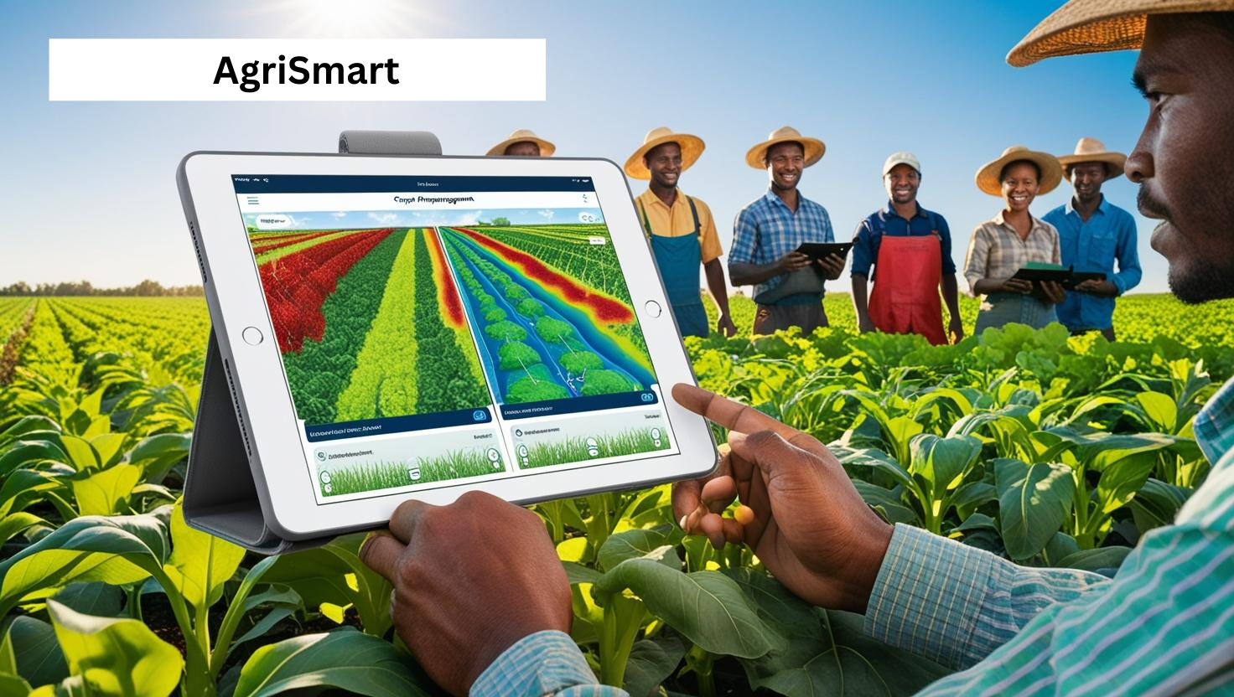
Solution:
This project introduces an AI-powered system to tackle key agricultural challenges such as crop diseases, improper fertilizer use, and excessive pesticide application. By combining image processing and machine learning, the system offers a smart and sustainable approach to crop management.
Key Features:
Disease Detection: Analyzes leaf images to identify diseases early using AI, enabling timely action.
Fertilizer Recommendation: Suggests the right type and amount of fertilizer based on crop health, reducing chemical waste.
Pesticide Optimization: Recommends minimal, targeted pesticide use to lower costs and protect the environment.

Slide 6
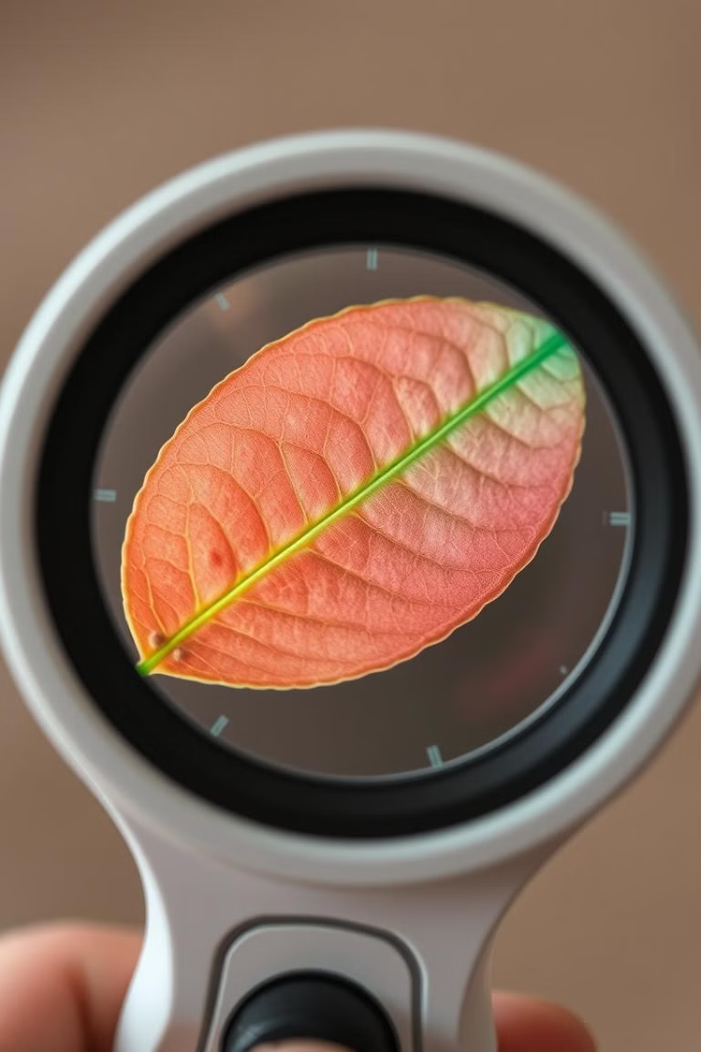
Image Processing and Disease Detection: How it Works
Image Acquisition: Farmers or users capture leaf or plant images using a smartphone. These images are uploaded to the system for analysis.
Classification Using AI: These features are fed into a trained model which : compare patterns with known disease datasets and predict the disease type or confirm plant health
Output and Recommendations : Once diagnosed, the system : Displays the disease name and severity , Suggests eco-friendly fertilizers and organic treatment options and Recommends minimal and targeted pesticide use if necessary.

Slide 7
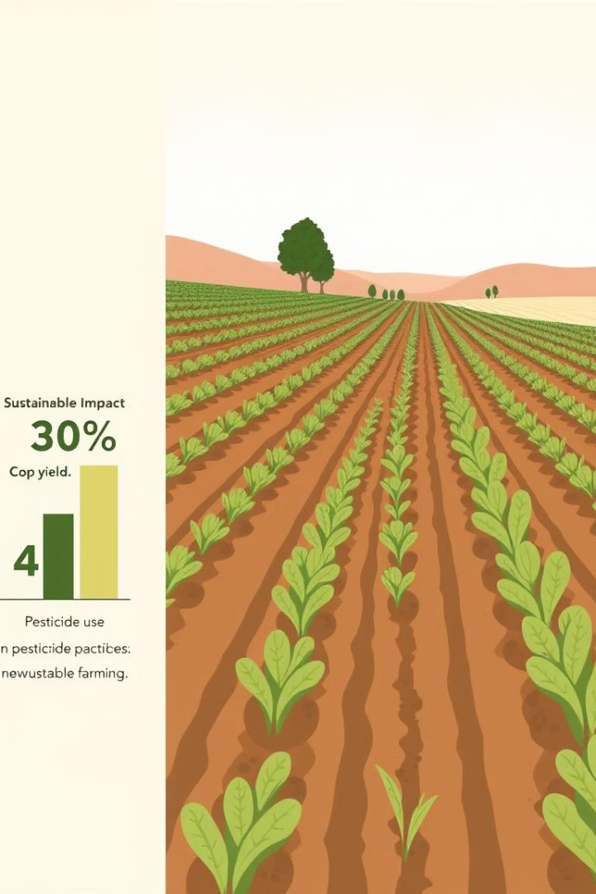
Results and Performance:
The AI-powered system achieved high accuracy in detecting crop diseases using image-based analysis, with a classification accuracy of 98% across various crop types.
By leveraging machine learning algorithms, it successfully identified early symptoms of diseases, enabling timely interventions.
Fertilizer recommendations were tailored to crop needs and soil conditions, improving yield efficiency while reducing excess usage.
The system also reduced pesticide dependency by promoting targeted treatments, leading to reduction in overall pesticide use.
These outcomes support more sustainable and eco-friendly agricultural practices.

Slide 8
Wow factor :
AI instantly diagnose the disease, suggest a solution, and recommend eco-friendly treatment.
Reduces pesticide use , helping preserve soil health and reduce groundwater contamination.
Every diagnosis made by our AI potentially prevents unnecessary pesticide use—one step closer to climate-smart agriculture

Slide 9
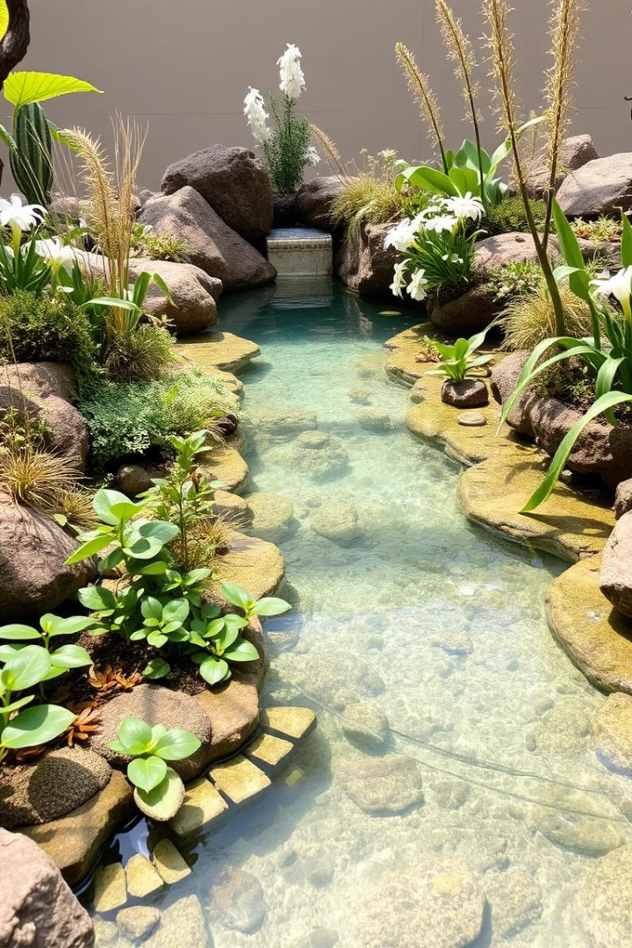
Promoting Sustainable Farming: Environmental Benefits
Reduced pollution from pesticides and fertilizers protects ecosystems.
Conservation of natural resources helps ensure long-term sustainability.
Improved soil health enhances productivity and resilience.
Support for biodiversity promotes a balanced environment.

Slide 10
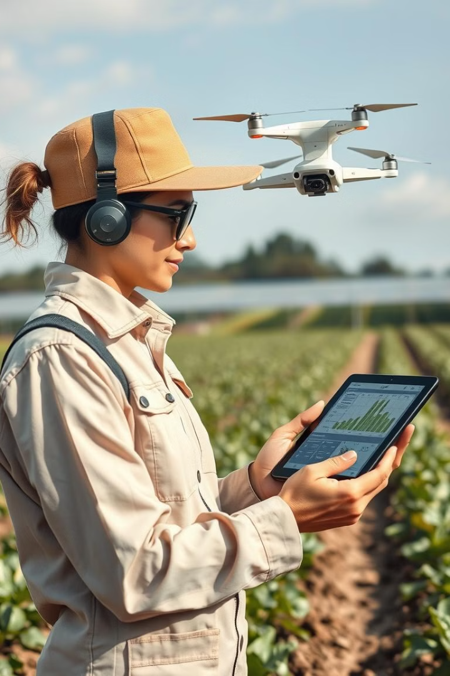
Future Scope:
Automated Fertilizer Application
A key component is the AI-controlled smart container deployed in the agricultural field.
This container is segmented into multiple compartments, each storing a different type of fertilizer tailored to specific crop diseases.
Once the AI detects a disease, it determines the most effective fertilizer for that condition.
It then activates the relevant compartment in the container, and the system automatically sprays the recommended fertilizer directly onto the affected crops.
.

Slide 11
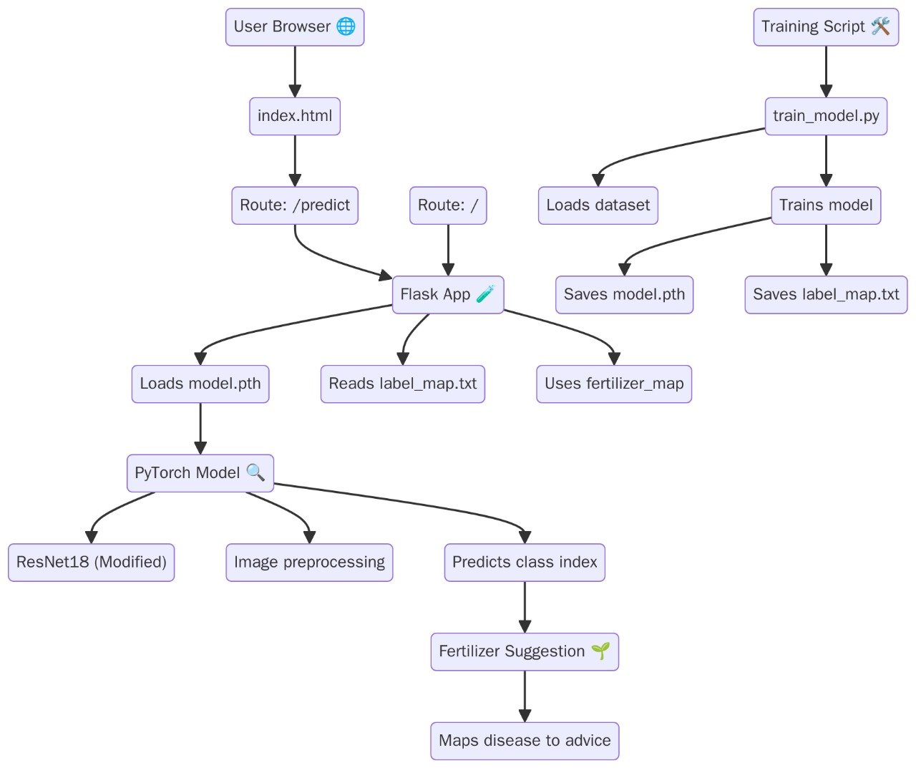
Block Diagram:

Slide 12

Conclusion :
This AI-powered system marks a significant step toward modernizing agriculture through smart technology. By accurately detecting crop diseases, recommending suitable fertilizers, and minimizing pesticide use, it promotes healthier crops and reduces environmental impact. The integration of image processing and machine learning not only improves efficiency but also empowers farmers with timely, data-driven solutions. Overall, this project supports sustainable farming practices and paves the way for a more intelligent, eco-friendly future in agriculture. It provides a path towards a healthier and more sustainable future for agriculture. By adopting AI-powered sustainable farming practices, we can improve crop health, protect the environment, and ensure food security.

Slide 13
Thankyou!

